Slide 1

Quantum Algorithm for Solving LSE
Rahul Manavalan
Student of Computational Science and Engineering
Technische Universität München

Slide 2
Desiderata
Problem Definition
Classical Solutions
Quantum Solution
Insight
Algorithm
Subtleties
Exceptions to the Rule
Viability
Classical Simulation
Old Faithful
Results

Slide 3
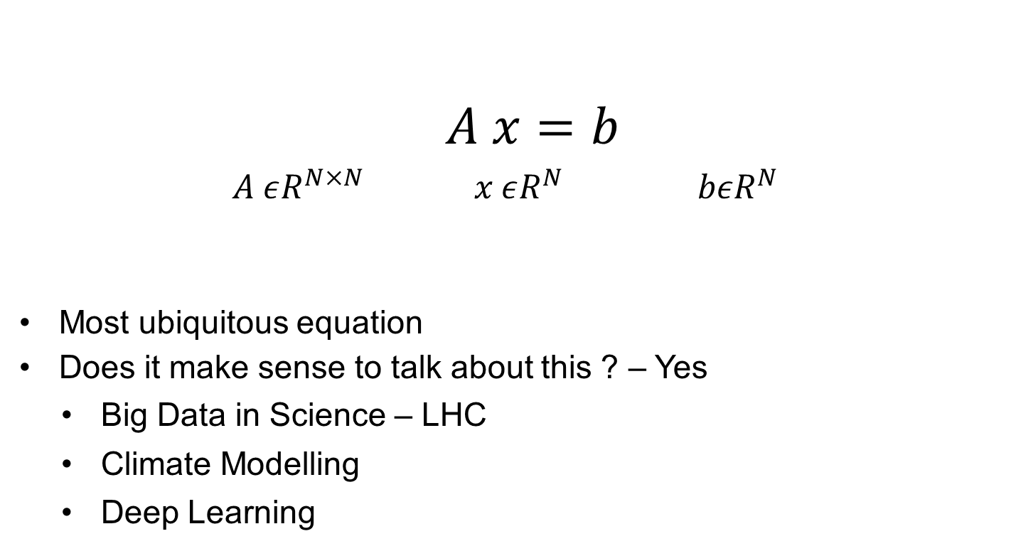
Problem Definition
$A x=b$
$A εR^{N×N} x εR^{N} bεR^{N}$
Most ubiquitous equation
Does it make sense to talk about this ? – Yes
Big Data in Science – LHC
Climate Modelling
Deep Learning

Slide 4
Classical Solutions
Dense Solvers and var.
Direct Solvers
Sparse Solvers and var.
Stationary Point Solvers
Iterative Solvers
Multigrid
Krylov Methods
Steepest Gradient Desc. , CG

Slide 5
Quantum Solution
HHL Algorithm – 2009
Harrow Hassidim Lloyd.
Exponential Speedups
Quantum Simulation – RPF
Shor‘s Algorithm
Grover‘s Search
HHL

Slide 6
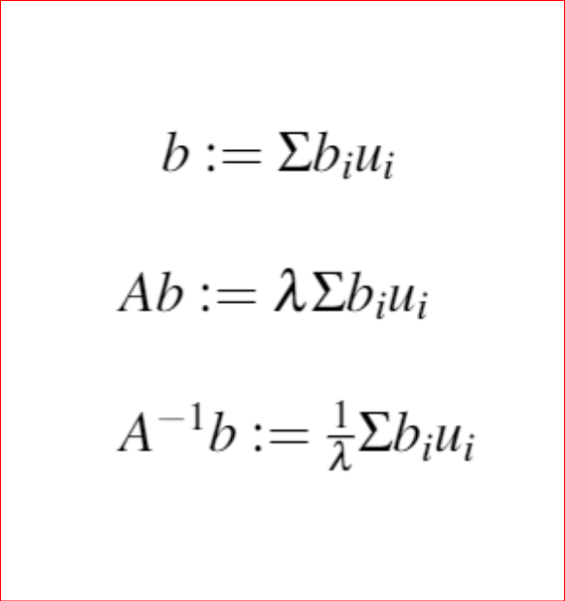
Insight
Any Matrix A and its inverse have reciprocating eigenvalues.
If there exists a quantum algorithm to compute λ and in turn 1/λ, we could compute x.

Slide 7
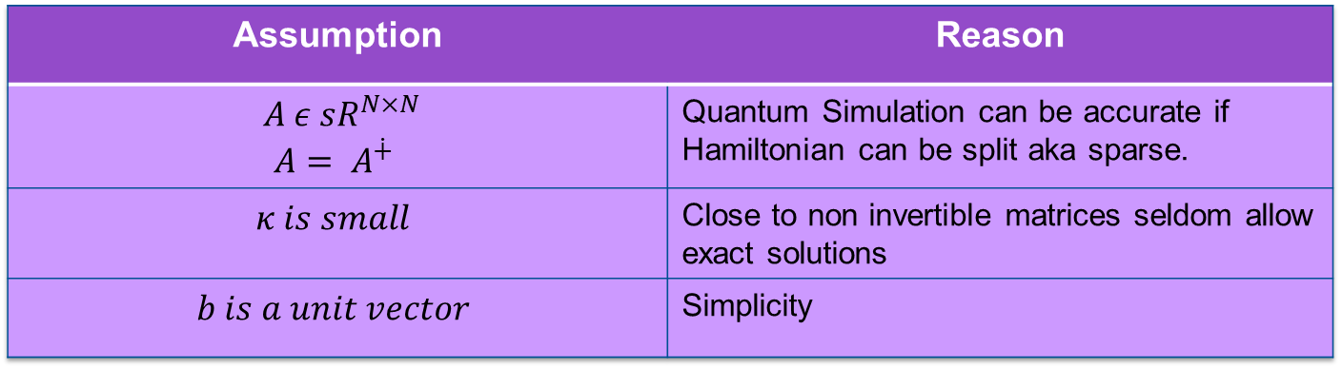
Assumptions from the HHL paper 2009
Assumption | Reason
$$A ε {sR}^{N×N}$$ $$A= A^{∔}$$ | Quantum Simulation can be accurate if Hamiltonian can be split aka sparse.
$$κ is small$$ | Close to non invertible matrices seldom allow exact solutions
$$b is a unit vector$$ | Simplicity
Unacceptable !
Assumptions are relaxed using reductions – stay tuned.

Slide 8









Algorithm – Components
$$R2$$
$$R2$$
$$R1$$
$$R1$$
Phase Estimation
I-Phase Estimation
Controlled Rotation
$$exp⁡\{iAt\}$$
$$exp⁡\{iAt\}$$
$$|b⟩$$
$$|x⟩$$

Slide 9

Brass Tacks – (i)
$$|b⟩$$
Encode using Amplitude encoding.
Amplitude encoding ?

Slide 10
Brass Tacks – (ii)
Simulate : A

Slide 11
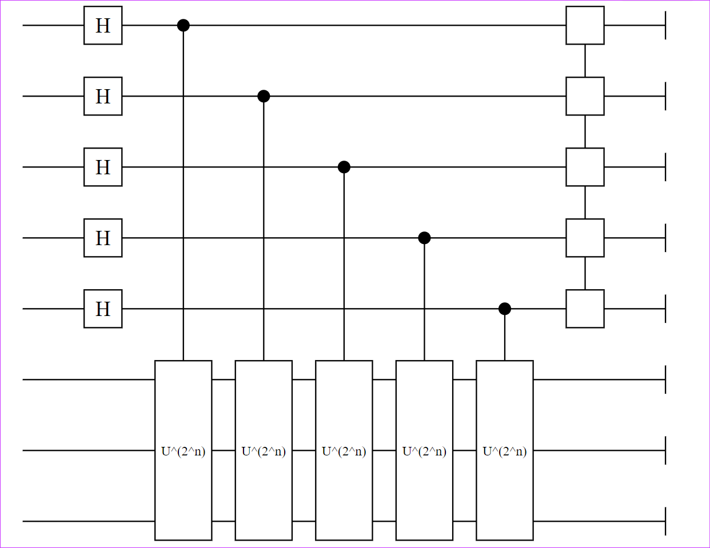
Brass Tacks – (iii)
Phase Estimation
IQFT

Slide 12
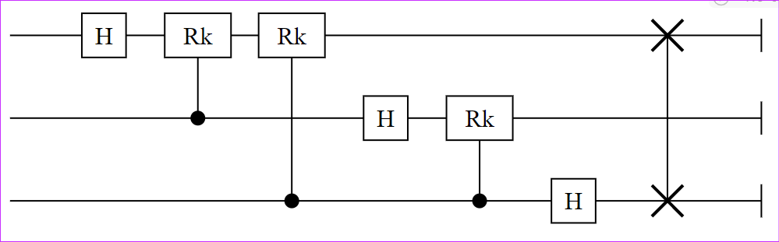
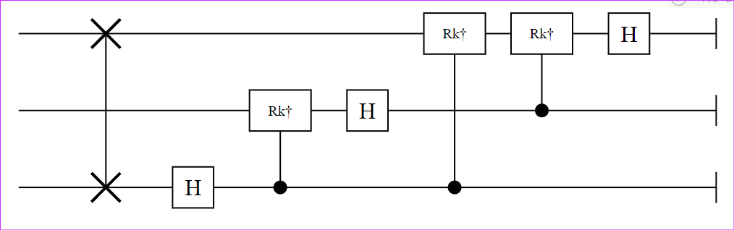
Interlude
QFT and IQFT

Slide 13
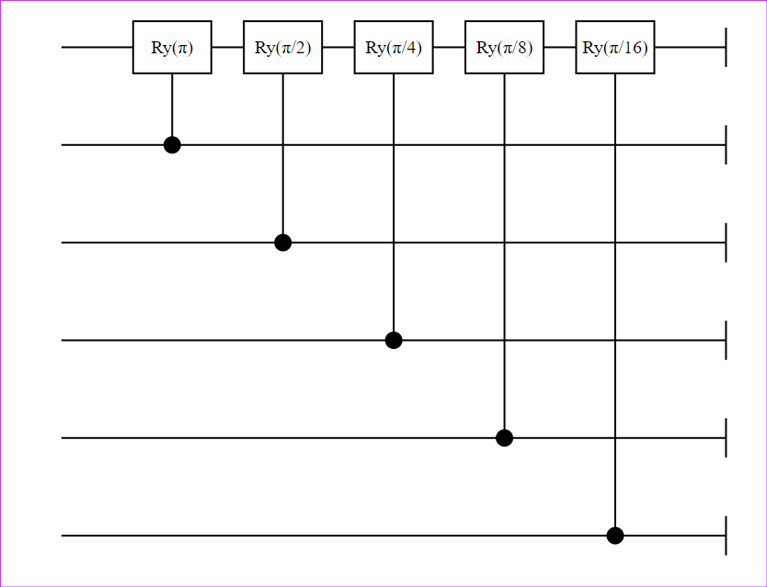
Brass Tacks – (iv)
Controlled Rotation

Slide 14
Brass Tacks – (v)
Un-compute PE

Slide 15

Brass Tacks – (vi)
Measure $\left|x\right\rangle$ with respect to M

Slide 16
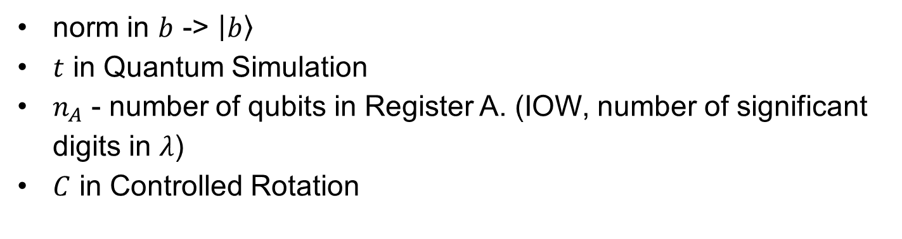
Caveats
norm in $b$ -> $\left|b\right\rangle$
$t$ in Quantum Simulation
$n_{A}$ - number of qubits in Register A. (IOW, number of significant digits in $λ$)
$C$ in Controlled Rotation

Slide 17

Not so subtle answers
$\left|b\right\rangle ε H⇒$
$\frac{C}{λ}$ $is the prob of success in Controlled Rotation.$
$$Ideally C=λ if we require that the algorithm succeeds every time.$$

Slide 18
Exceptions to the Rule
Non Hermitian Matrices
Non Square Matrices
Dense Matrices
Non Invertible Matrices

Slide 19
Viability
Computational Complexity

Slide 20
Viability
Physical Implementation

Slide 21
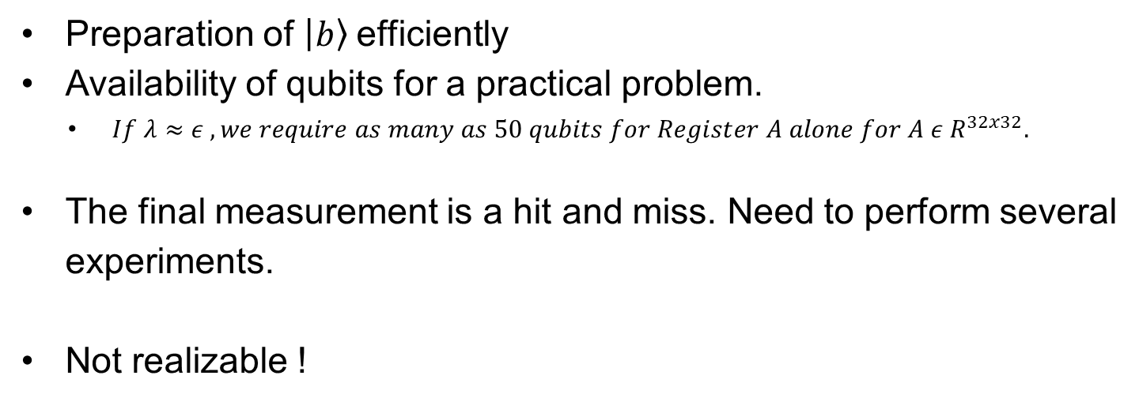
Difficulties in Actual Q.Computation
Preparation of $\left|b\right\rangle$efficiently
Availability of qubits for a practical problem.
$If λ≈ε , we require as many as 50 qubits for Register A alone for A ε R^{32x32}.$
The final measurement is a hit and miss. Need to perform several experiments.
Not realizable !

Slide 22
Classical Simulation
Yao.jl
Quaintum.jl
Qiskit Terra

Slide 23

Old Faithful – Poisson Equation
$Δu={−δ}_{t}u$ ; $x ε [0,π]$ ; $t ε \left[0,4π\right]$
$δΩ :u\left(π,:\right)=0 ;u\left(0,:\right)=0$
$u_{i}\left(:,0\right)=\sin\left(x\right)$
Finite Difference Method.

Slide 24
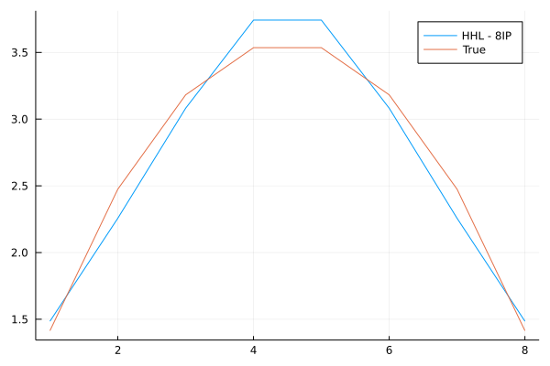
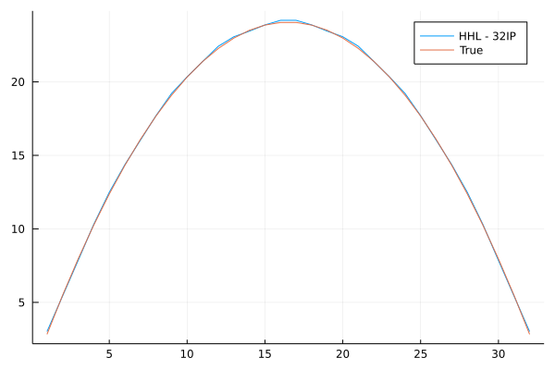
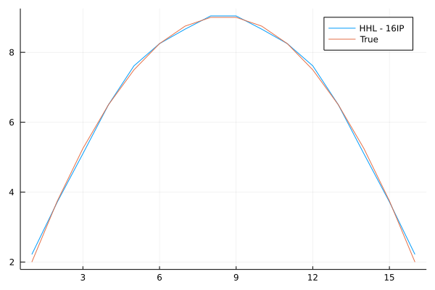
Results
1D

Slide 25
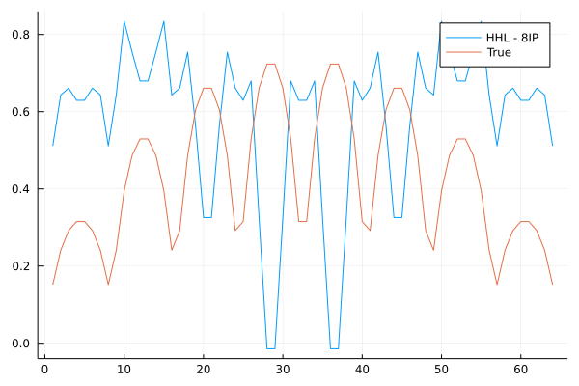
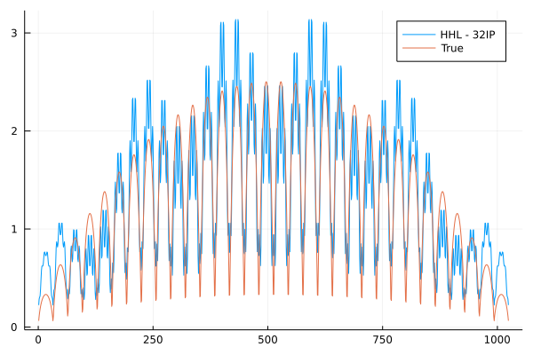
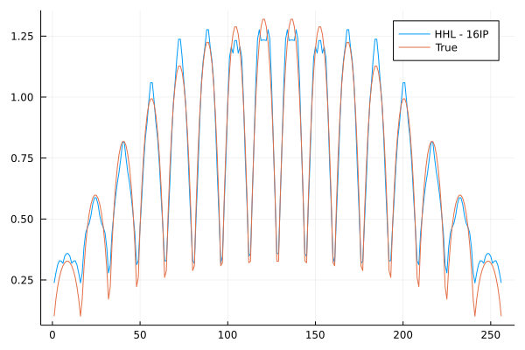
Results
2D

Slide 26
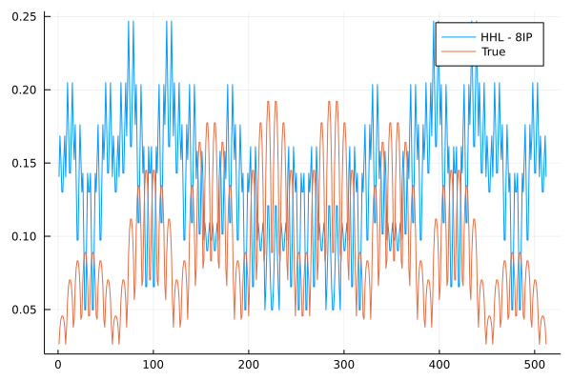
Results
3D

Slide 27
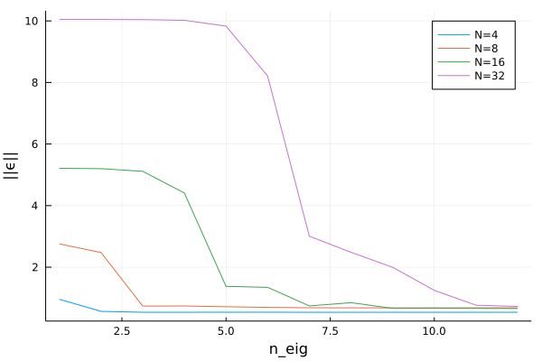
Results
Error Analysis – 1D

Slide 28
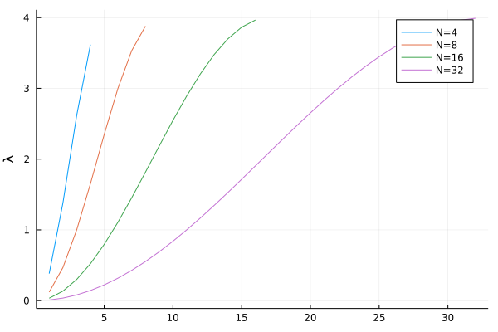
Results
Error Analysis – 1D – Inference

Slide 29
More on HHL
Baseline Implementation
Rahul Manavalan / Solving the Heat Equation with the HHL Algorithm · GitLab (lrz.de)
Elaborations into the claims made in the HHL paper.
The Why of HHL.

Slide 30
References
Read the fine print (nature.com) : Prelude
1301.2340.pdf (arxiv.org) : Box to Box Solution
1302.1210.pdf (arxiv.org) : Experimental Implementation albeit for a small system.
qiskit-terra/exact_reciprocal.py at a9289c085036002fa864b30edcd0b8ce066ea858 · Qiskit/qiskit-terra (github.com) : Exact reciprocal.

